Slide 1
Insurance Refund

Slide 2
Process Insurance Refund
Opening Script - Welcome to Grihum Housing Finance Limited. My name is (Agent Name) How may I assist you?
Customer - I have received a message from the Insurance Team regarding an insurance refund. Kindly share the refund amount and related details
AI - Please note that this call is being recorded for quality assurance and training purposes.
AI - To verify the information, kindly provide the registered mobile number ( To check the details in finnone slide 3)
AI - Verification - Any 3 of the below verification questions needs to be answered ( To verify the customer details slide 4 )
NAME
Date of Birth
Registered Email ID
Loan Sanction Amount
EMI Amount
AI - Thank you, Sir/Madam. Your verification has been completed.
If there are two LANs, AI should first confirm the specific sanctioned amount, as the LAN number is not recollected.
Once confirmed, proceed with the relevant LAN number. Check Point: FinnOne, Slide 4.
AI – As we receive the insurance amount from the Insurance Team
AI – We are raising a request for the insurance refund. The refund amount will be credited to your registered bank account within 10 working days (to raise the the request in CRM the slide starts from 5 to 14 )
AI - Any other details required apart from this?
Thankyou for calling Grihum Housing Finance Limited. Have a pleasant day!

Slide 3
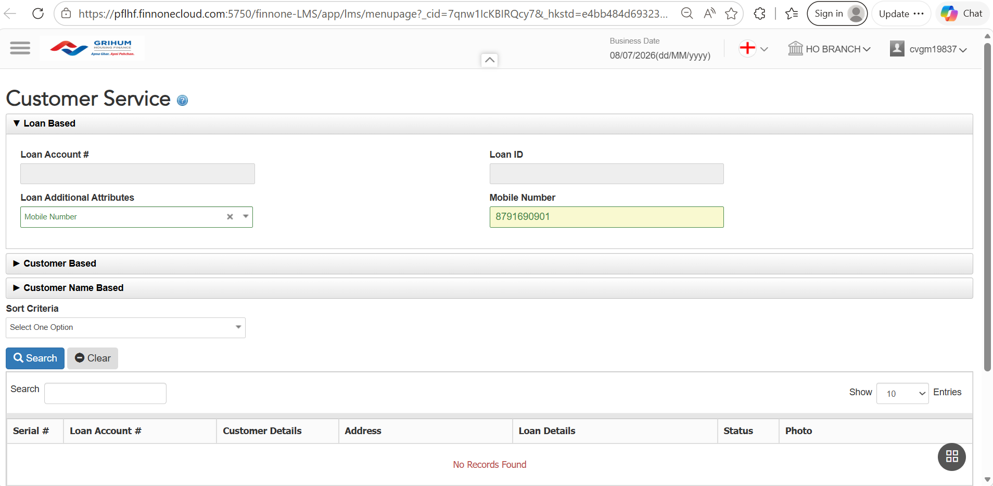
FINONE ​​​
To verify the information, please provide the customer's registered mobile number.​​​

Slide 4
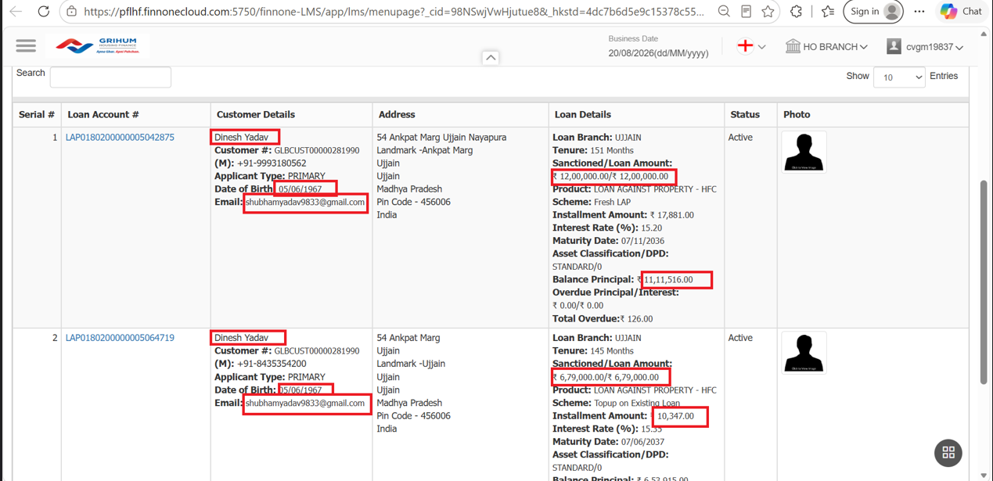
Verification - Any 3 of the below verification questions needs to be answered

Slide 5
CSR TAGGING

Slide 6
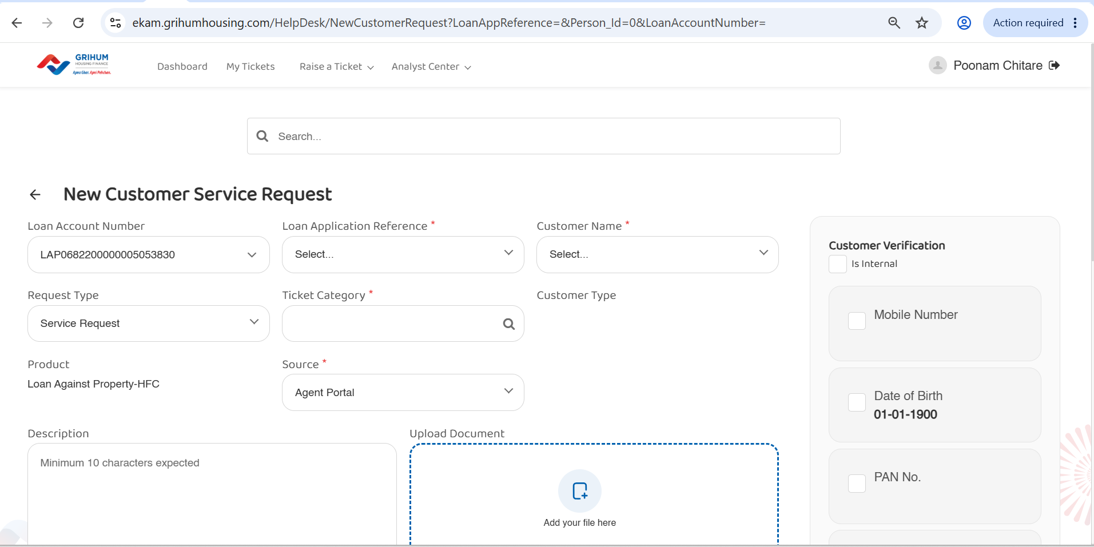

Slide 7
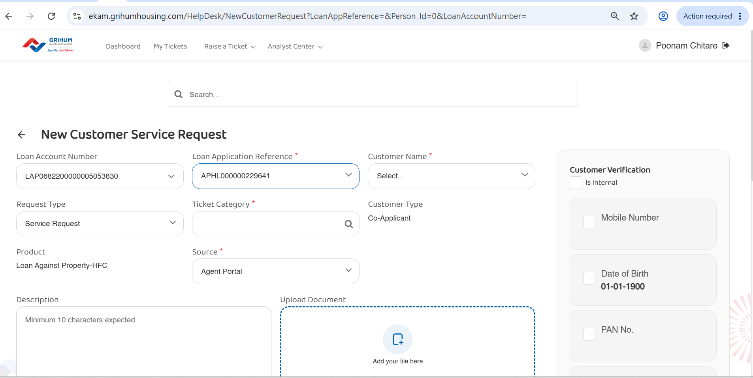

Slide 8
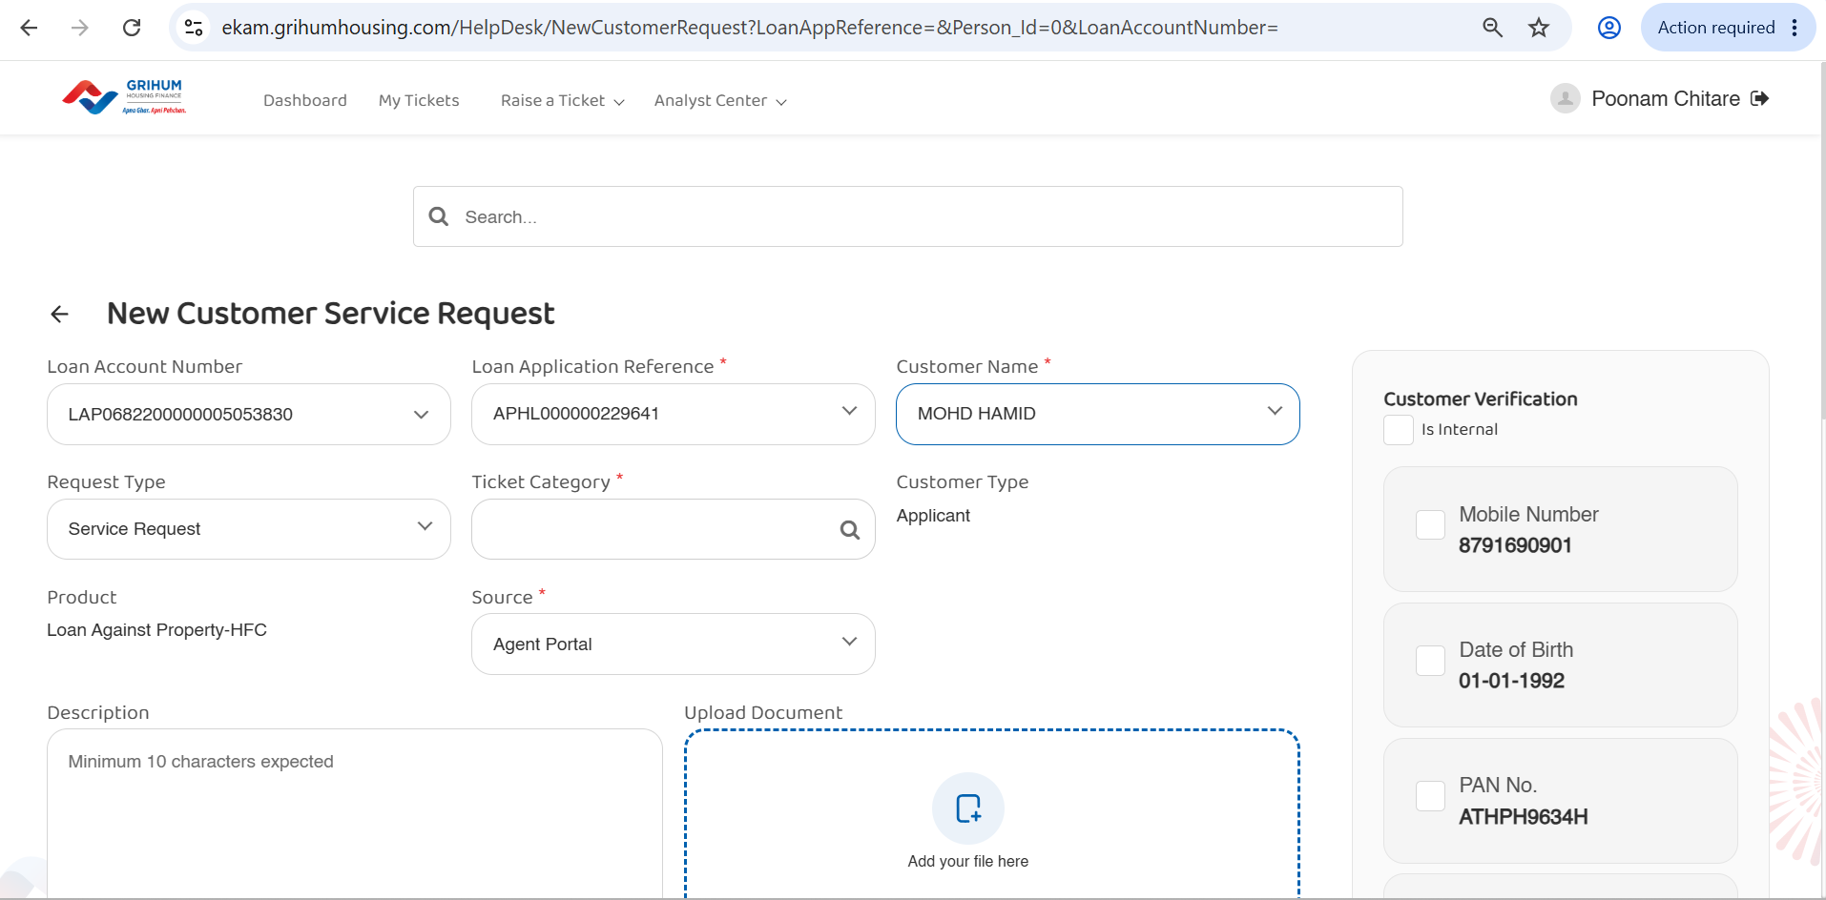

Slide 9
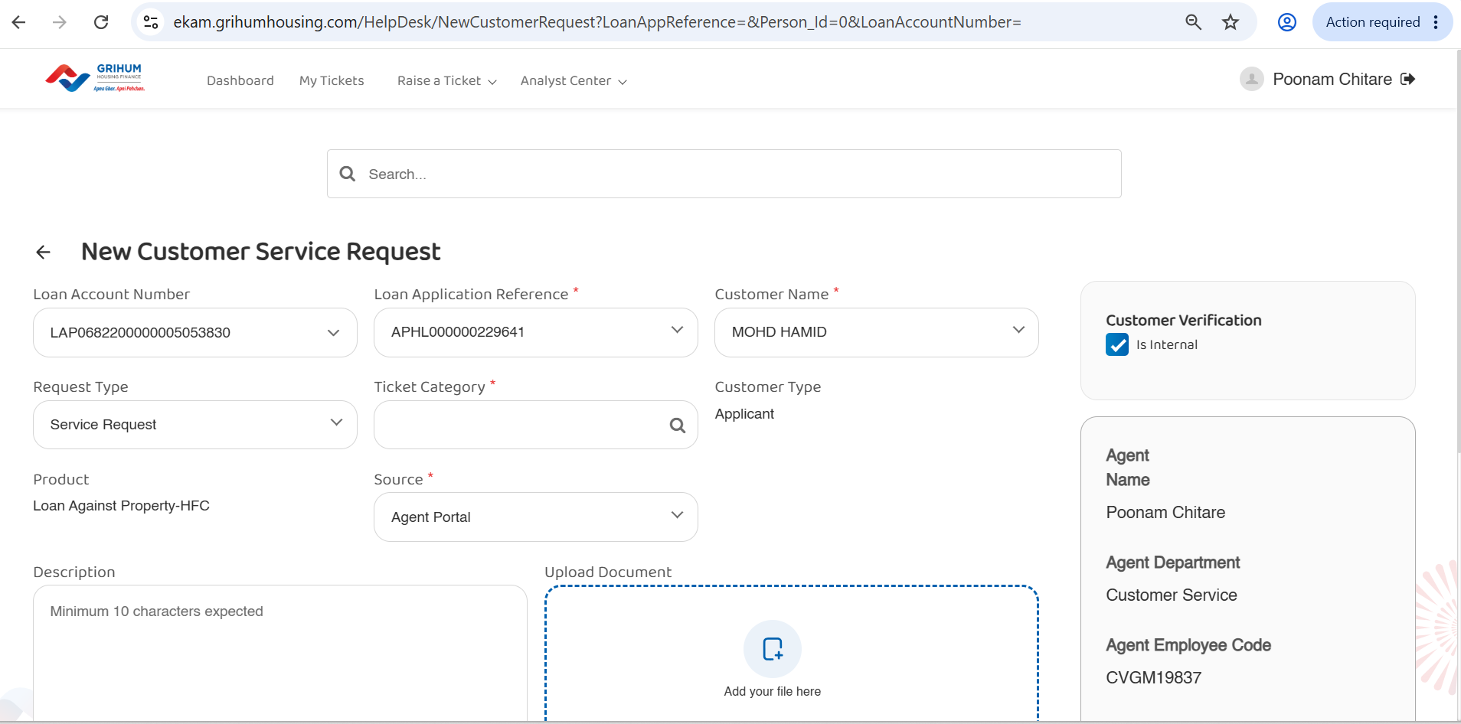

Slide 10
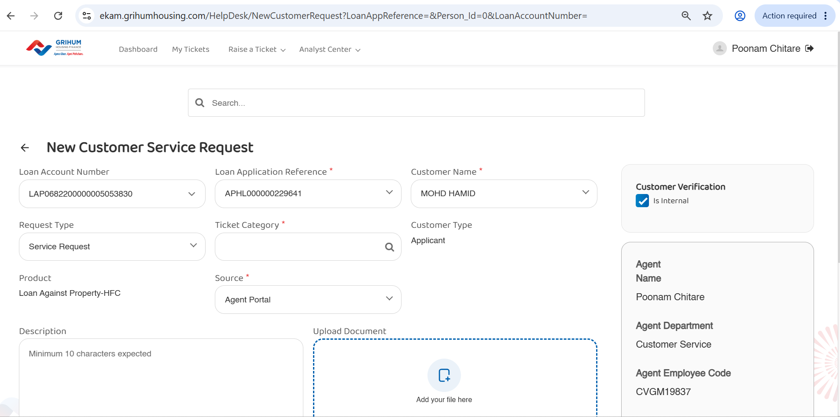

Slide 11
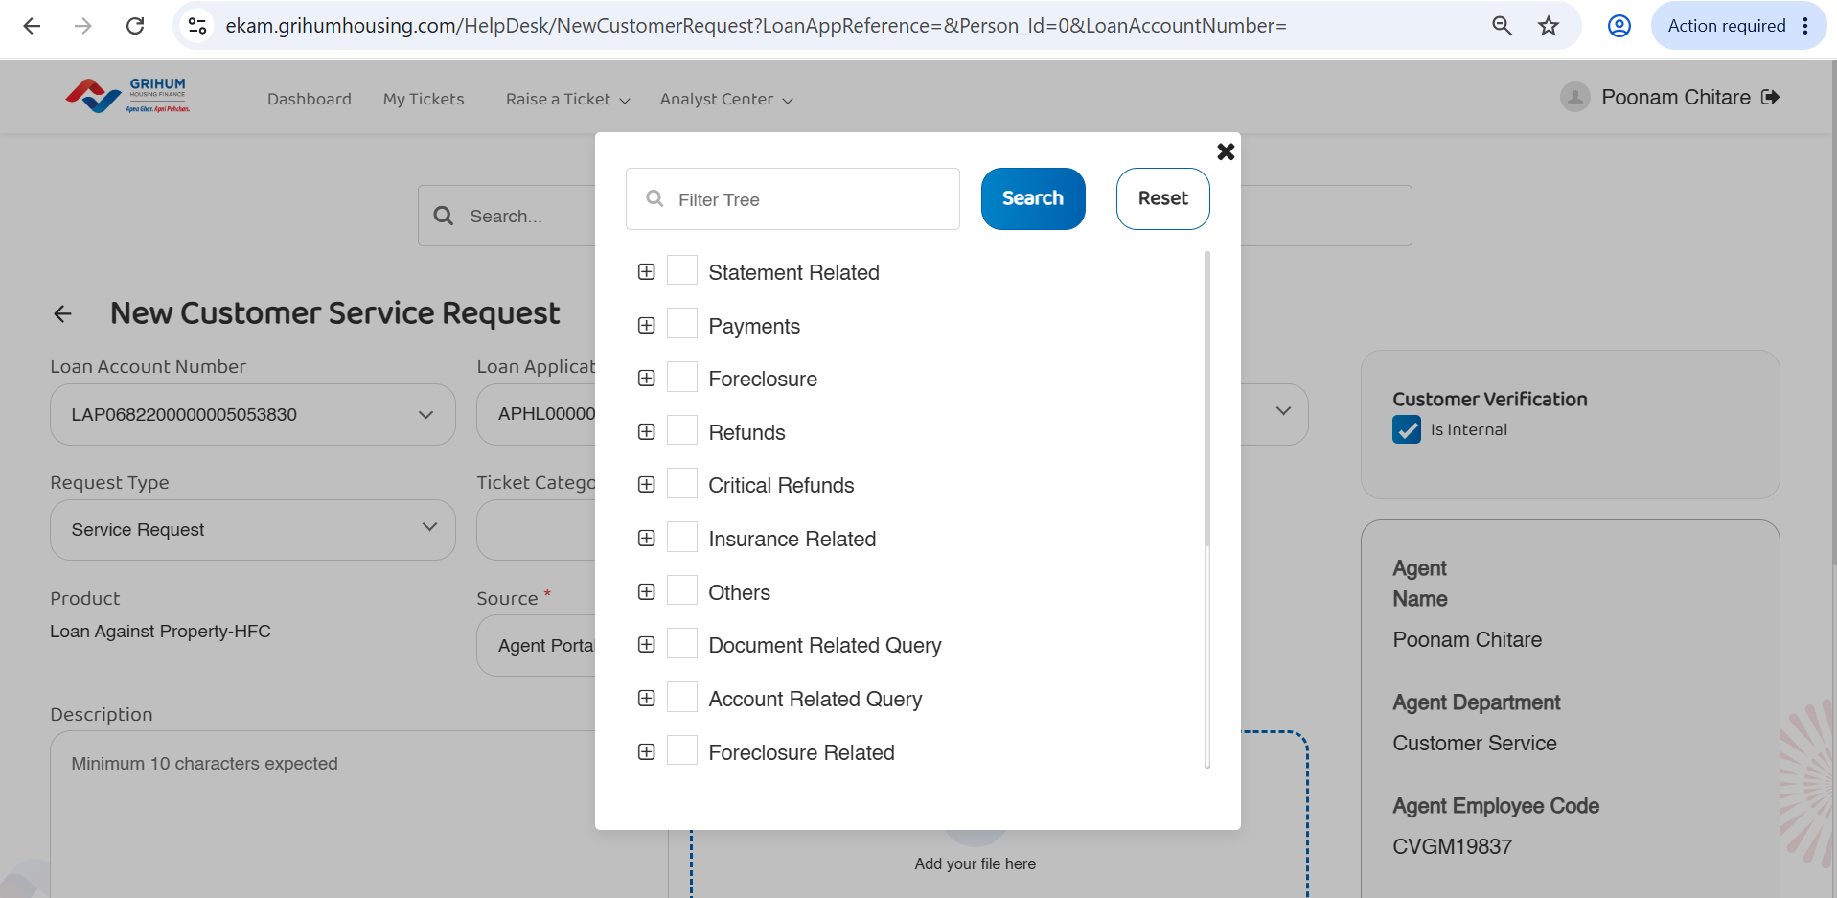

Slide 12
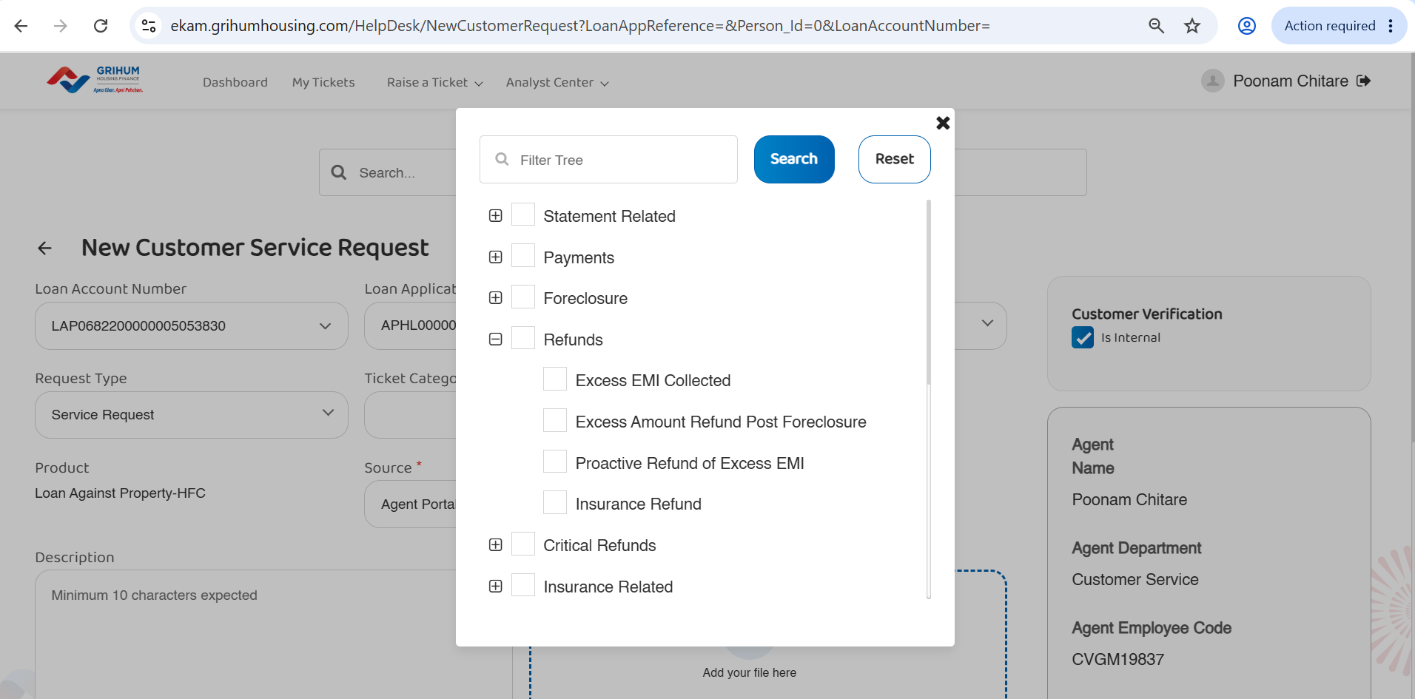

Slide 13
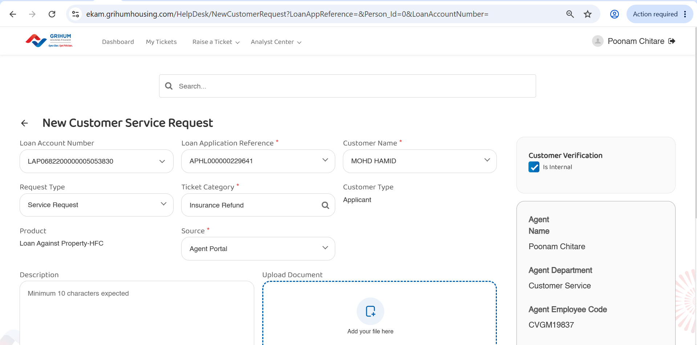

Slide 14
